Slide 1
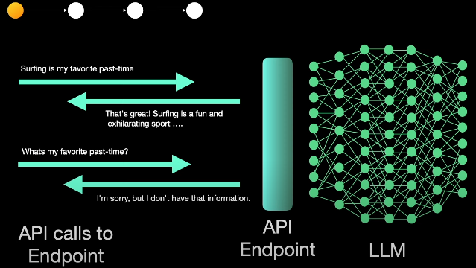
π
Context Window
llms are stateless
LLM are stateless what does it mean?
it means llms themselves don't keep track of conversations History
Notes:
Content: https://www.linkedin.com/pulse/chunking-strategies-ai-data-kash-kashyap-0lghe/

Slide 2
π
but when we talked about chatgpt client application it keep track our conversation history(state).so how it is happened, it is happened through the chatgpt client application not by LLM.
what happens as conversational history becomes very long
each llm has a maximum limit of words or tokens it can handle on each input prompt this is called the context window the context window refers the maximum amount of text in terms of tokens that the LLM can process at once
why can't LLM providers just increase the context window
so that all input requests can always be handled well
the larger the context window means more compute resources are required on the server side to handle this additional workload and this can be quite costly
llama2 has a context window size of 4K
Claude2 has a context window size of 100K
GPT3.5 has a context window 16k
GPT 4.0 has a context window 128k
LLM has context window size for input and output both
just like output context window size 4k of GPT-3.5 and GPT-4.0
Notes:
Content: https://www.linkedin.com/pulse/chunking-strategies-ai-data-kash-kashyap-0lghe/

